Slide 1
MOVIE RECOMMENDATION SYSTEM
Home
About me
What I do
My experience
My work

Slide 2

01
introduction
Home
About me
What I do
My experience
My work
This Photo by Unknown Author is licensed under CC BY-SA-NC

Slide 3
Recommendation System
A Recommender system, or a recommendation system, is a subclass of information filtering system that seeks to predict the “rating” or “preference” a user would give to an item.
Recommender systems aim to predict users’ interests and recommend product items that quite likely are interesting for them.
Netflix: 2/3 of movies watched are recommended Google news: recommendation generates 38% clickthrough Amazon: 35% sales from recommendation.
This Photo by Unknown Author is licensed under CC BY-SA-NC

Slide 4
Types of Recommendation Engines
CONTENT-BASED
COLLABORATIVE
HYBRID
Home
About me
What I do
My experience
My work
Filtering
Filtering
Recommendation

Slide 5
Content-Based filtering
The Content-Based Recommender relies on the similarity of the items being recommended.
The basic idea is that if you like an item, then you will also like a “similar” item.
A content based recommender works with data that the user provides, Based on that data, a user profile is generated, which is then used to make suggestions to the user.
As input size from user increases, the system become more and more accurate and efficient.

Slide 6
Collaborative Filtering
The Collaborative Filtering Recommender is entirely based on the past behavior and not on the context.
More specifically, it is based on the similarity in preferences, tastes and choices of two users. It analyses how similar the tastes of one user is to another and makes recommendations on the basis of that.
Collaborative filtering is the workhorse of recommender engines. The algorithm has a very interesting property of being able to do feature learning on its own, which means that it can start to learn for itself what features to use.

Slide 7
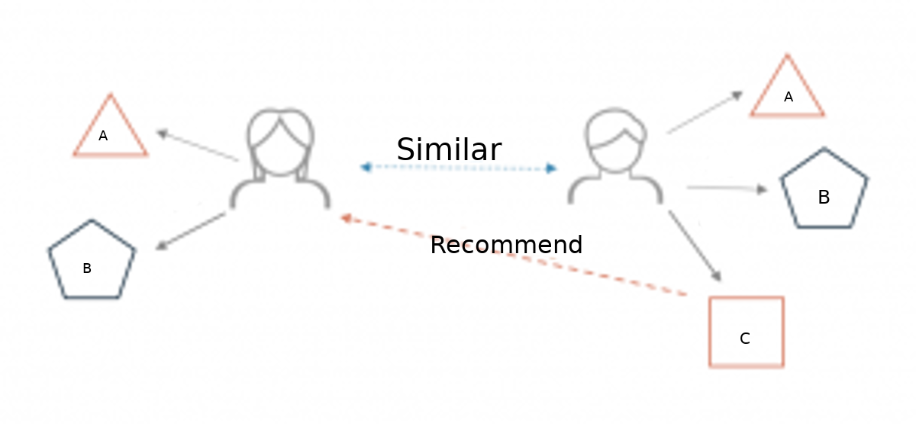
For Example,
Two users buy the same items A and B from an e-commerce store. When this happens the similarity index of these two users is computed. Depending on the score the system can recommend item C to the other user because it detects that those two users are similar in terms of the items they purchase.

Slide 8
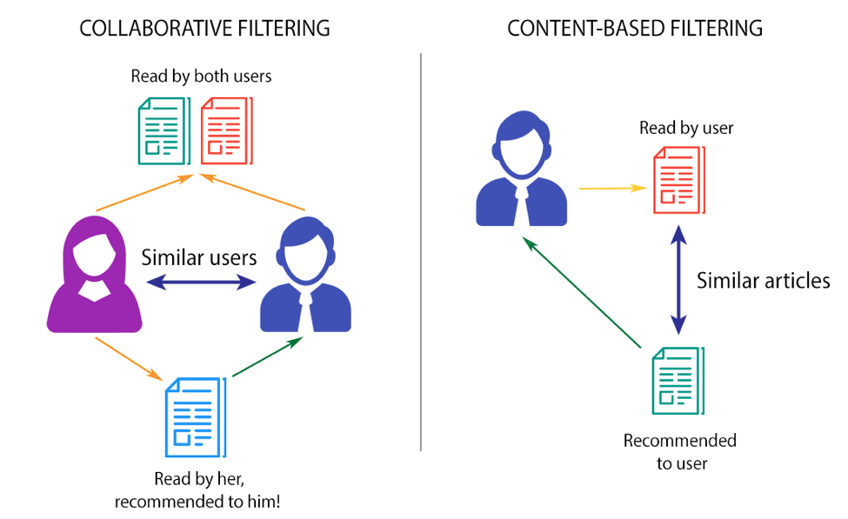

Slide 9
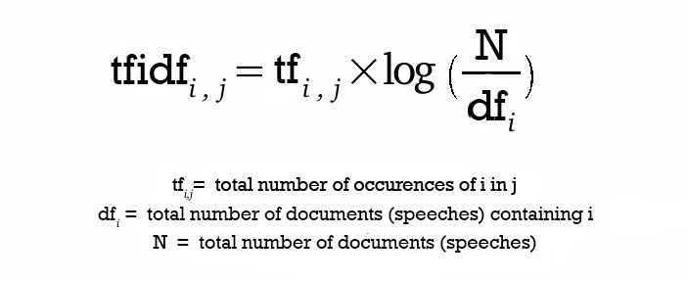
Content-Based Recommendation Model
To determine the relative importance of a document / article / news item / movie etc., concepts used are:-
Term Frequency (TF) - This is simply the frequency of a word in a document.
Inverse Document Frequency (IDF) - This the inverse of the document frequency among the whole corpus of documents.
TF-IDF weighting negates the effect of high frequency words in determining the importance of an item (document).

Slide 10
After calculating TF-IDF scores, in order to determine which items are closer to each other, rather closer to the user profile vector space model is used.
It computes the proximity based on the angle between the vectors.
Steps:-
Each item is stored as a vector of its attributes (which are also vectors) in an n-dimensional space and the angles between the vectors are calculated to determine the similarity between the vectors.
The user profile vectors are also created based on his actions on previous attributes of items and the similarity between an item and a user is also determined in a similar way.
Example:-Sentence 2 is more likely to be using Term 2 than using Term 1.

Slide 11
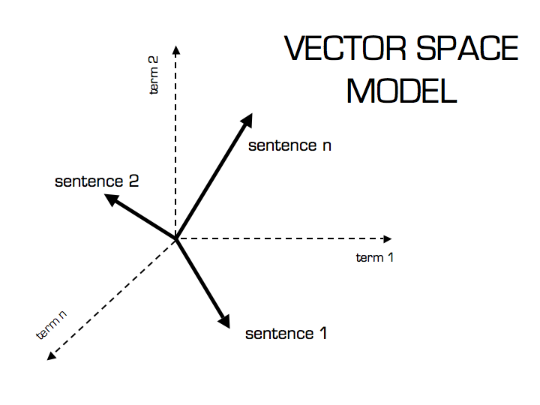
The method of calculating this relative measure is calculated by taking the cosine of the angle between the sentences and the terms. The reason behind using cosine is that the value of cosine will increase with decreasing value of the angle between which signifies more similarity.
Cosine calculation is simply the sum-product of vectors.

Slide 12
Collaborative Filtering based recommendation system
Collaborative Filtering is based on Matrix Factorization (MF). Matrix factorization is widely used for recommender systems where it can deal better with scalability and sparsity than Memory-based.
The goal of MF is to learn the latent preferences of users and movies
When we have a very sparse matrix, with a lot of dimensions, by doing matrix factorization, you can restructure the user-item matrix into low-rank structure, and you can represent the matrix by the multiplication of two low-rank matrices, where the rows contain the latent vector.

Slide 13
Item-based Collaborative Filtering
The concept in this case is to find similar movies instead of similar users and then recommending similar movies to that ‘A’ has had in his/her past preferences.
This is executed by finding every pair of items that were rated/viewed/liked/clicked by the same user, then measuring the similarity of those rated/viewed/liked/clicked across all user who rated/viewed/liked/clicked both, and finally recommending them based on similarity scores.
Here, for example, we take 2 movies ‘A’ and ‘B’ and check their ratings by all users who have rated both the movies and based on the similarity of these ratings, and based on this rating similarity by users who have rated both we find similar movies.
So if most common users have rated ‘A’ and ‘B’ both similarly and it is highly probable that ‘A’ and ‘B’ are similar, therefore if someone has watched and liked ‘A’ they should be recommended ‘B’ and vice versa.

Slide 14
Singular value decomposition
We will be using Singular value decomposition (SVD) as our matrix factorization method—to reduce the dimensionality of the data matrix.
SVD is an algorithm that decomposes a matrix A into the best lower rank (simpler) approximation of the original matrix A.

Slide 15
Advantages and Disadvantages

Slide 16
using content-based recommendation
Advantages-:
No need for data on other users, thus no cold-start or sparsity problems.
Can recommend to users with unique tastes.
Can recommend new & unpopular items.
Can provide explanations for recommended items by listing content-features that caused an item to be recommended (in our case, movie genres)
Disadvantages-:
Finding the appropriate features is hard.
Does not recommend items outside a user's content profile.
Unable to exploit quality judgments of other users.

Slide 17
Using Collaborative recommendation
advantages
Unlike people’s taste, movies don’t change.
There are usually a lot fewer items than people, therefore easier to maintain and compute the matrices.
Shilling attacks are much harder because items cannot be faked.

Slide 18
Hybrid Recommendation System:
Home
About me
What I do
My experience
My work
A hybrid recommendation system is a special type of recommendation system which can be considered as the combination of the content and collaborative filtering method. Combining collaborative and content-based filtering together may help in overcoming the shortcoming we are facing at using them separately and also can be more effective.

Slide 19
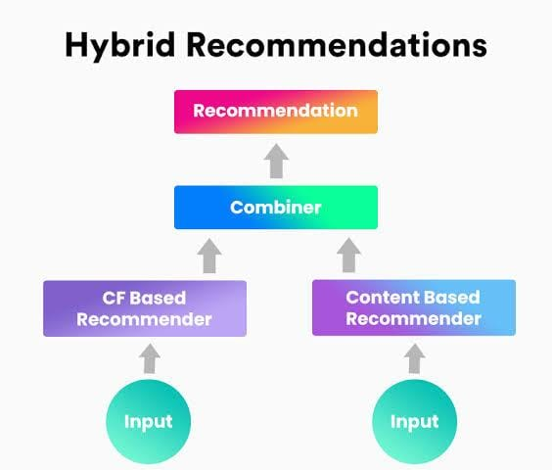
After calculating cosine similarity between a movie vector with respect to all other movies .Weighted average is used to suggest top N movies to the user.
Weighted average = Cosine score(content) + cosine score(collaborative)/2
A good recommendation system is essential for better predicting the user’s habit. Hybrid recommendation system is one of the most effective way to improve our model. By combining different approaches above, we can better customize our model to fit the recommendation condition and dataset requirements.

Slide 20
result
Home
About me
What I do
My experience
My work

Slide 21
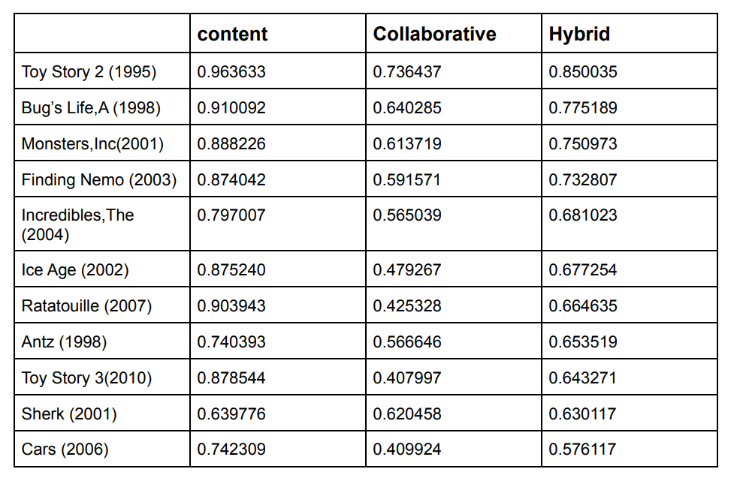
When user watches a movie our model recommends top 10 movies with highest hybrid cosine similarity score for instance the user has selected or watched Toy story which is an animated movie similar animated movies like Toy Story 2, Bugs Life, Monsters, inc, Finding nemo etc., are recommended.

Slide 22
GROUP MEMBERS: b. SATHVICK(19bec009) I. PAVIThRA(19bec017) P. MOHAN BABU(91bec031) P. SRIRAM(19bec033)
Home
About me
What I do
My experience
My work
THANK you

